Slide 1
Python Data Visualization

Slide 2
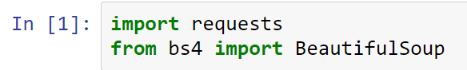
Crawler library
1. requests is used to send HTTP requests and responses.
2. BeautifulSoup is used to analyze and grab elements in HTML.

Slide 3
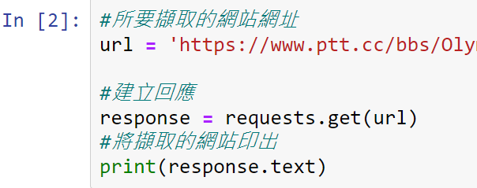
Get website source code
After setting a variable url to store the website to be retrieved, we will then use the requests.get() function to obtain the source code of this website.

Slide 4
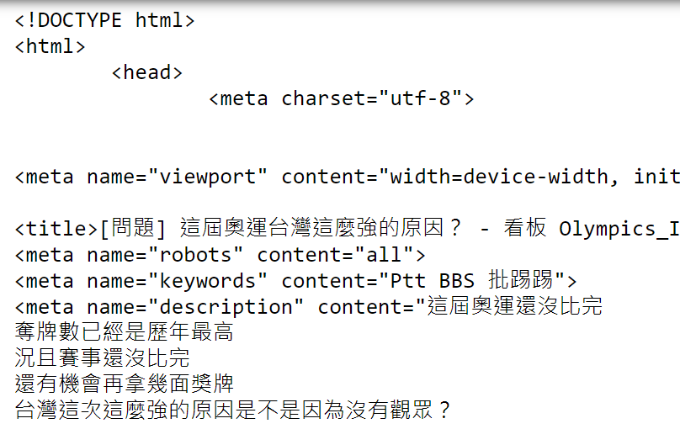
Print website data
The printed content will probably look like this:

Slide 5
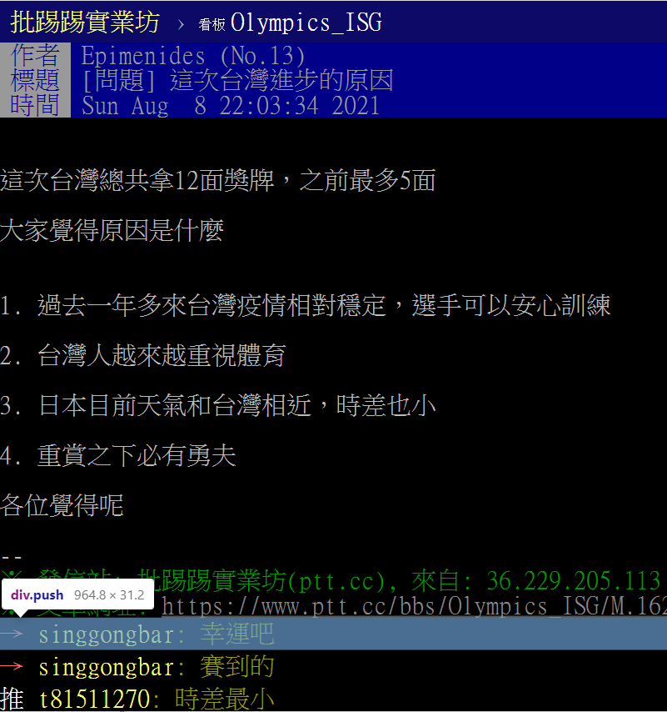
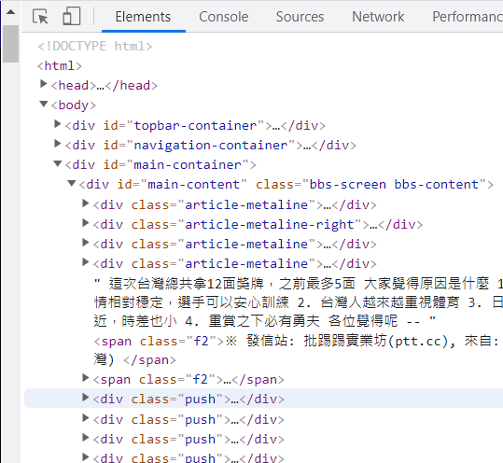
Search ptt pushes
Then we can use (F12, Developer Tools) to observe where ptt’s pushes will be placed.

Slide 6
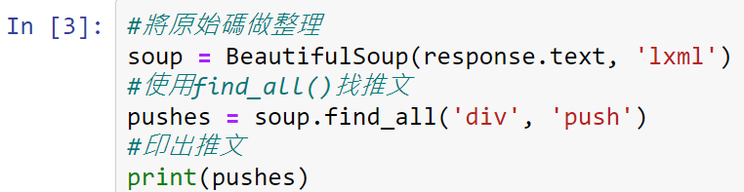
Use find_all() to find pushes
We find that the message will be placed in the div label with class = "push“.
Here we will use the find_all() function to operate BeautifulSoup to find push.

Slide 7
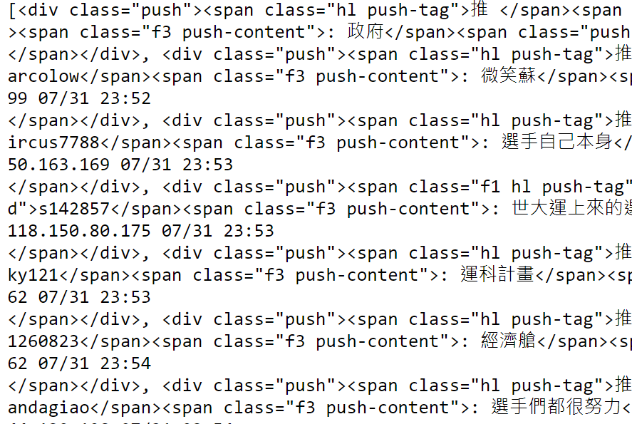
Print out all pushes
Print out all the contents in the div tag with class = "push":

Slide 8
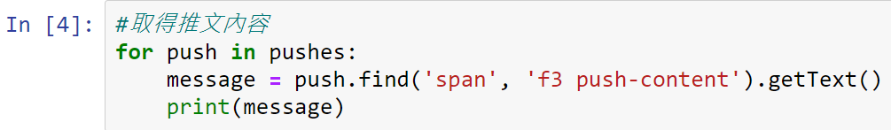
Retrieve pushes
We want to retrieve the push, and we can find it is in the span tag of class="f3 push-content“.

Slide 9
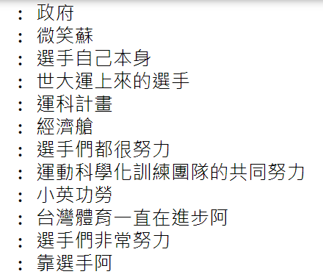
Retrieve pushes (Cont’d)
The printed results are as follows:

Slide 10
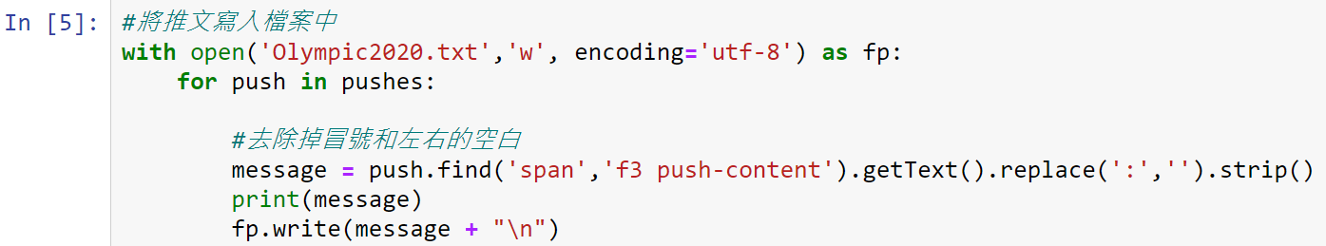
Remove colons
We can use the replace() function to remove the colon and then use strip() to remove blanks.

Slide 11
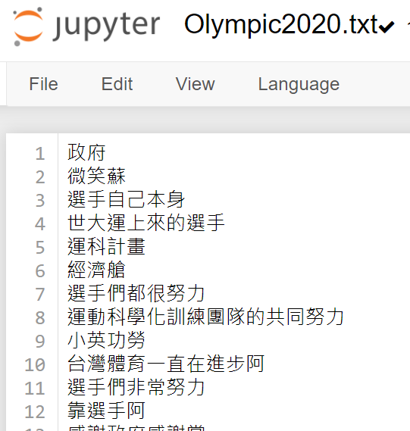
Remove colons (Cont’d)
The pushes in ptt website were successfully saved to Olympic2020.txt.

Slide 12
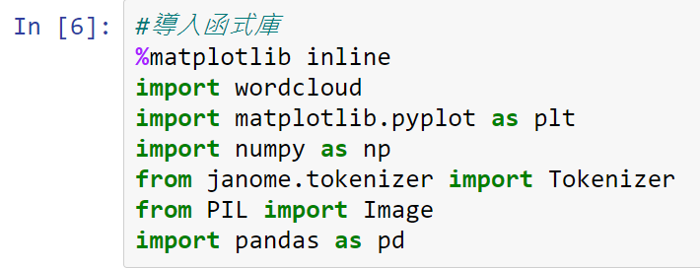
Start drawing word cloud
To draw a word cloud, we will use the wordcloud library. The wordcloud can recognize a string of blank characters as a single word, and then make it as word cloud.

Slide 13
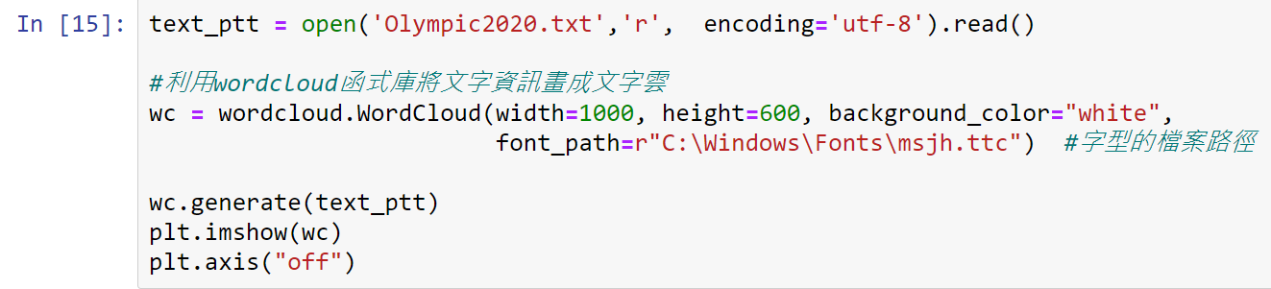
WordCloud function
The parameter width in WordCloud can set the width, the parameter height can set the height, and the parameter background_color can set the background color of the word cloud.

Slide 14

WordCloud function (Cont’d)
Word cloud output:

Slide 15

Change the mask image
First we need to prepare a silhouette picture.
You can download pictures from the following website: https://www.flaticon.com/
Please note that the image format must be png.
In the following example, we use the heart image (like.png) as a word cloud mask.

Slide 16
Change the mask image (Cont’d)
The parameter mask in WordCloud can specify a mask image.
In order to see the shape of the mask clearly, we can add a border to the mask. At this time, we use the parameter contour_width to set the thickness of the border, and the parameter countou_color to determine the border color.
colormap can sets the color of text in the word cloud.

Slide 17
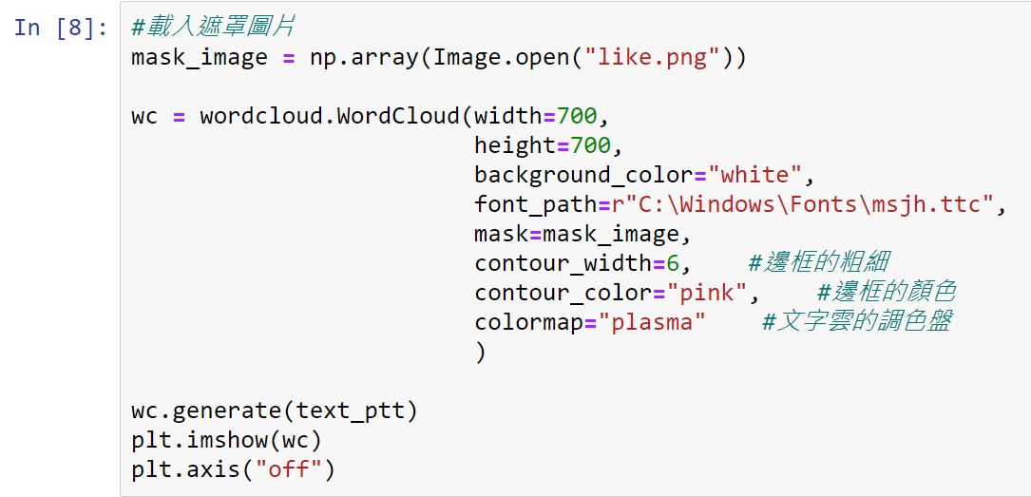
Change the mask image (Cont’d)

Slide 18

Change the mask image (Cont’d)
Output after changing the mask:

Slide 19
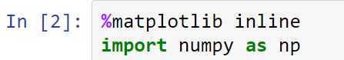
Numpy
Numpy is a basic function library required for scientific operations using Python, including array operations.
Generally speaking, we will call the Numpy function with the name of the np. Load Numpy with import numpy as np.

Slide 20
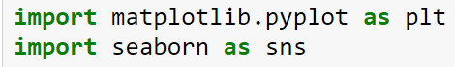
Matplotlib & Seaborn
Matplotlib is a classic library that uses Python visualization data, which can be used to display charts in Python development environments such as Jupyter Notebook.
Seaborn is a Python visualization data library based on matplotlib, which can make the visualization statistics more beautiful.

Slide 21
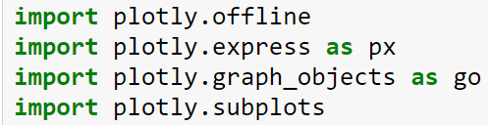
Plotly
Plotly is a library that can draw dynamic charts, and can also use preset values to beautify the chart.

Slide 22
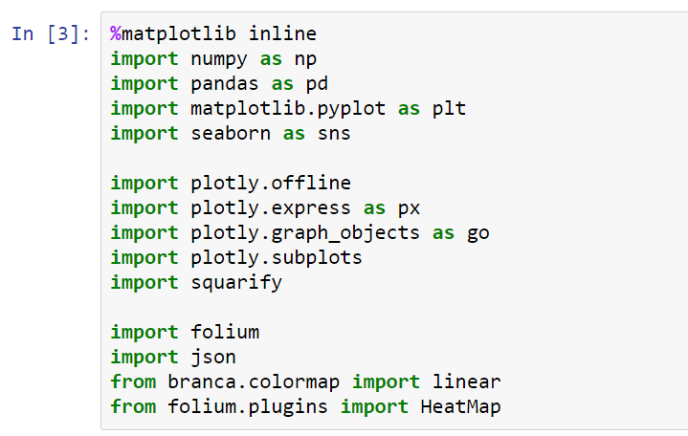
Import full library

Slide 23
Get weather data from website
We provide you with the following two methods to obtain weather data from the web:
Click the download button on the website, download the file to your computer, and then upload the file to jupyter notebook.
Use web crawlers to obtain website information and data.
URL link: http://e-service.cwb.gov.tw/HistoryDataQuery/MonthDataController.do?command=viewMain&station=C0AC70&stname=%25E4%25BF%25A1%25E7%25BE%25A9&datepicker=2021-06

Slide 24
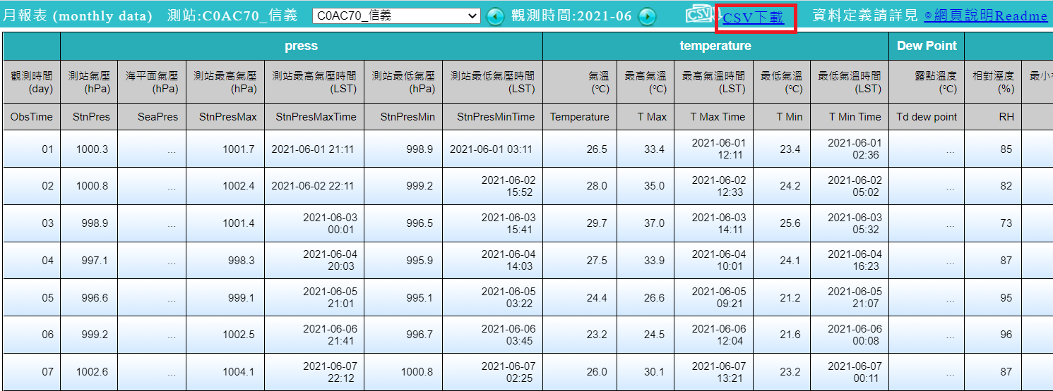
Method 1: Download the file
You can use the URL we provided before to link to the website and download the data.

Slide 25
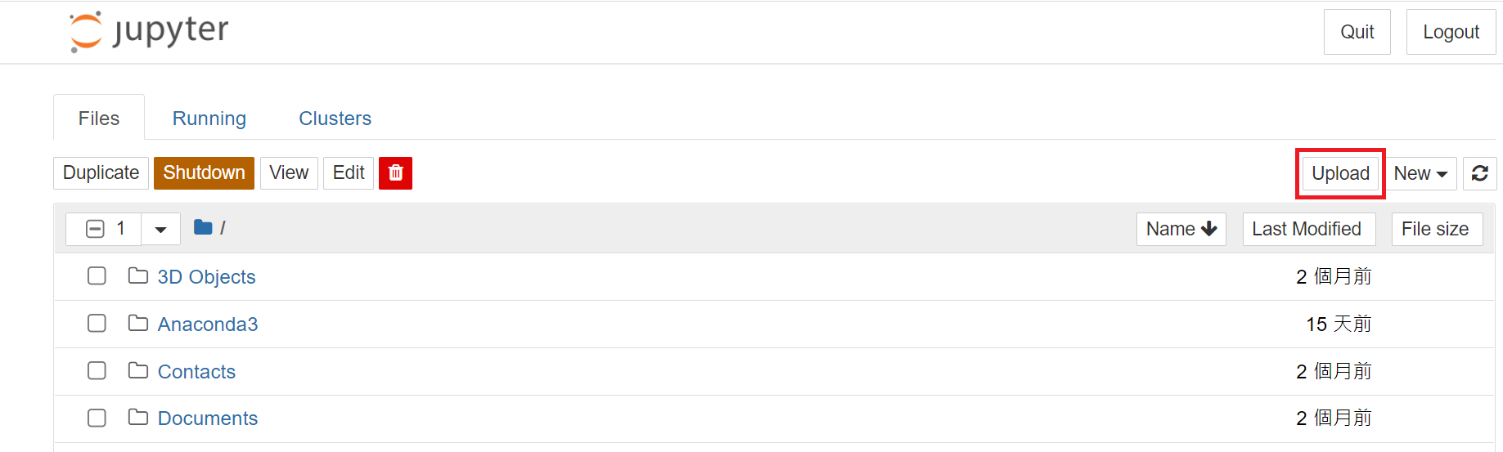
Method 1: Upload the file to jupyter
Upload the downloaded file to Jupyter Notebook.

Slide 26
Method 2: Web crawlers
First of all, we need to print out the website information in jupyter to determine what data we need.

Slide 27
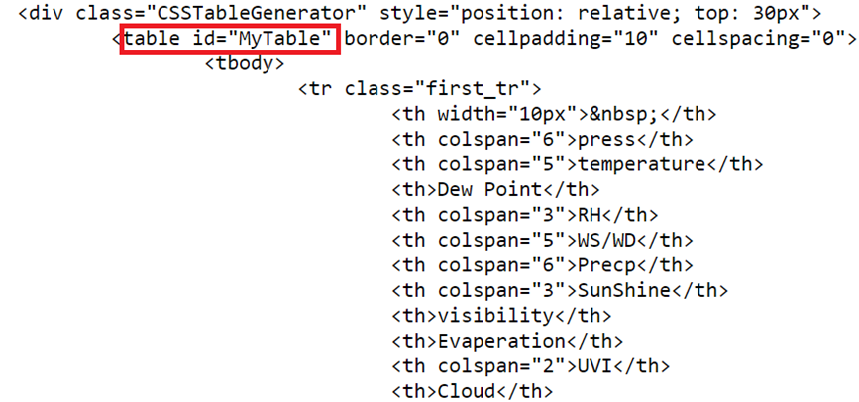
Method 2: Find table id
After executing the program described on the previous page, you can display detailed web information in Jupyter Notebook.

Slide 28
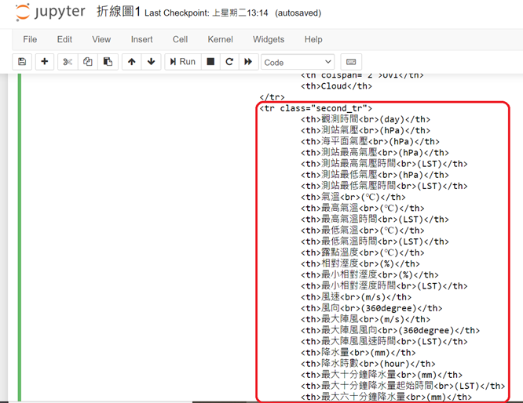
Method 2: Find the data we need
Find the data we need, and we can recognize that they are all wrapped in <tr>, <td> and <th> label.

Slide 29
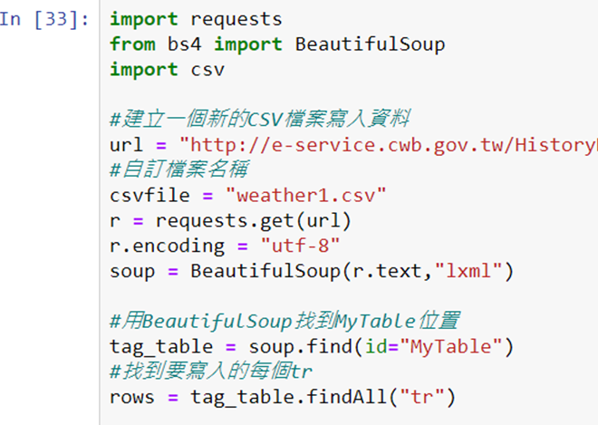
Method 2: Web crawlers detail
url = “http://e-service.cwb.gov.tw/HistoryDataQuery/MonthDataController.do?command=viewMain&station=C0AC70&stname=%25E4%25BF%25A1%25E7%25BE%25A9&datepicker=2021-06”

Slide 30
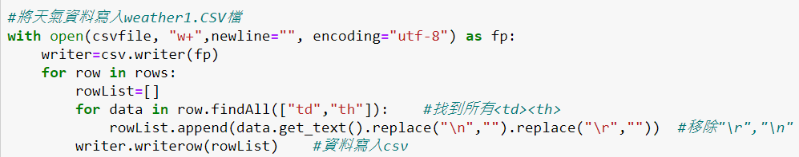
Method 2: Crawl the data we need
The append() function is used to add new objects at the end of the list.
writerows() write all the elements in rows into the csv file, and format it according to the current variables.

Slide 31
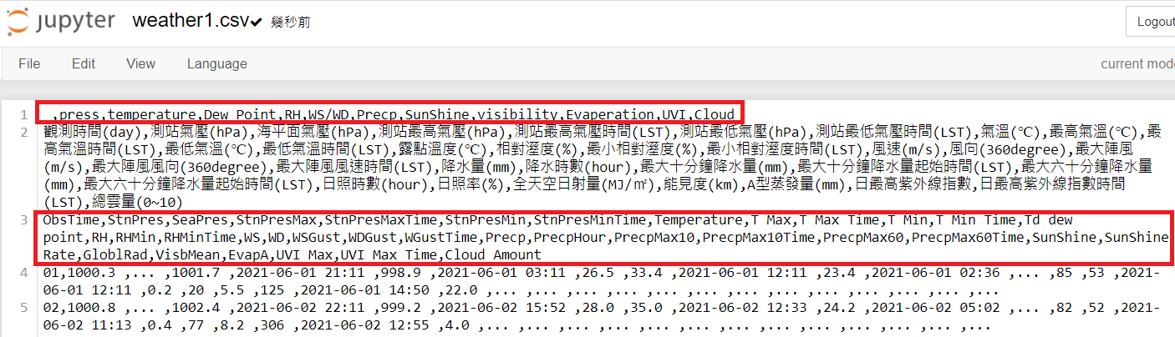
Method 2: Delete the data
Delete the data that may cause errors (the red box in the figure below).

Slide 32
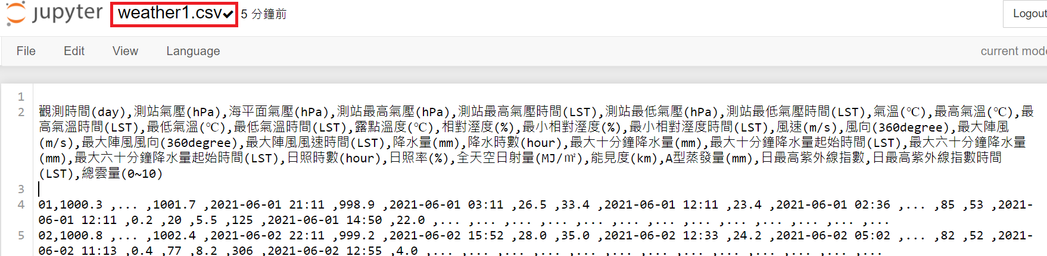
Method 2: Web crawler execution results
Confirm that the web page data has been written to weather1.csv.

Slide 33
Load weather1.csv
First, load the observation “觀測時間(day)” column of weather1.csv with date type.
And assign the column list loaded in datetime format representing the time to the parameter parse_dates at this time.
If this step is not performed, the polyline cannot be drawn when charting.

Slide 34
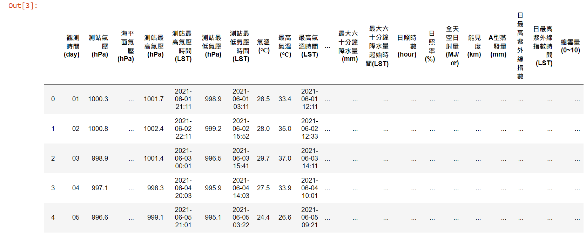
Load weather1.csv (Cont’d)

Slide 35
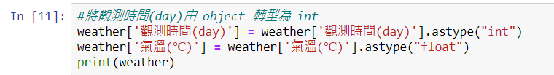
Data type conversion
The data type captured by the web crawler may be object, which may cause the problem that the line chart cannot be drawn. At this time, we need to manually force it to int or float data type.

Slide 36
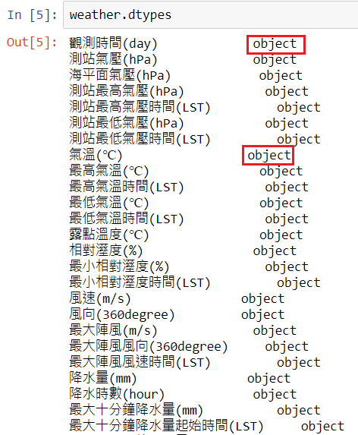
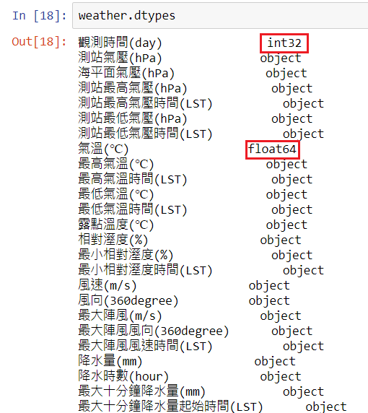
Data type conversion (Cont’d)

Slide 37
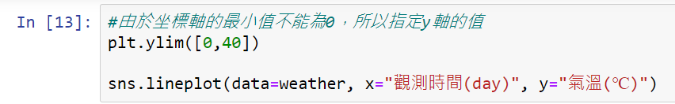
Draw a line chart
Line charts can be drawn using the sns.lineplot function.
The first step is to specify the column of the horizontal axis in the parameter x. Then specify the vertical axis field in the parameter y.

Slide 38
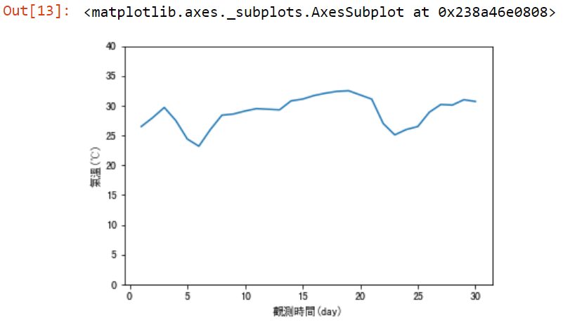
Draw a line chart (Cont’d)
Output

Slide 39
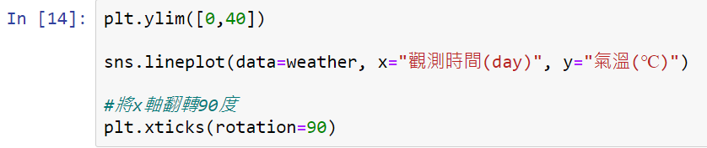
Straighten the horizontal axis scale
If the string of the horizontal axis is too long, it may cause the scale to be covered, so we use the setting of plt.xticks(rotation=90) to make the scale of the horizontal axis become straight.

Slide 40
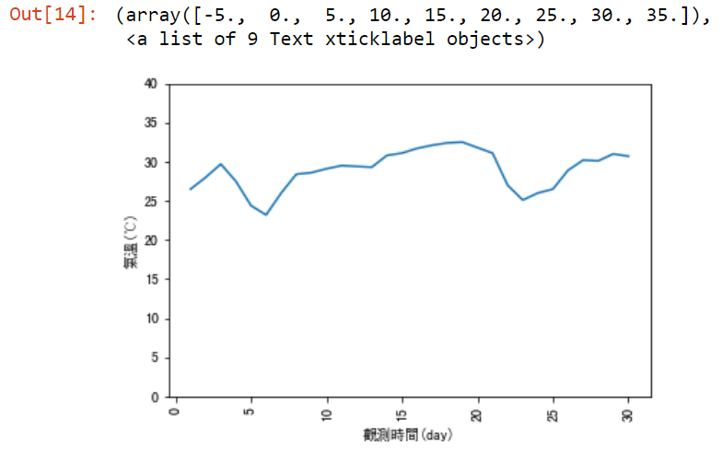
Straighten the horizontal axis scale (Cont’d)
Output:

Slide 41
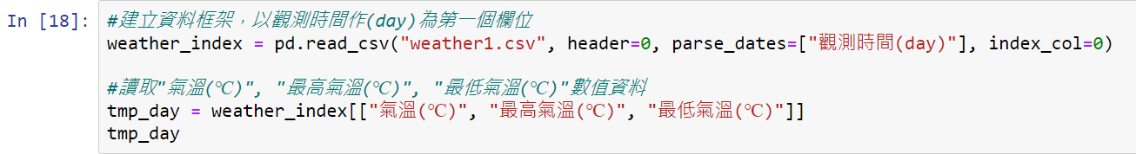
Draw multiple line charts
Then let us turn the “氣溫(℃)”, “最高氣溫(℃)”, “最低氣溫(℃)” line chart into the same chart.
The first step is to create a data frame. "觀測時間(day) " is the first column in weather1.csv, so when we use the pd.read_csv function to load the CSV file, we specify index_col as 0 (as the first column, that is, the "觀測時間(day) " column), so we can create a data frame with date.

Slide 42
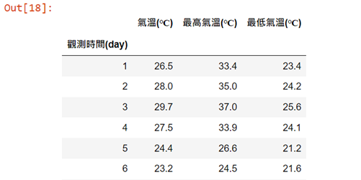
Draw multiple line charts (Cont’d)
Data frame output:

Slide 43
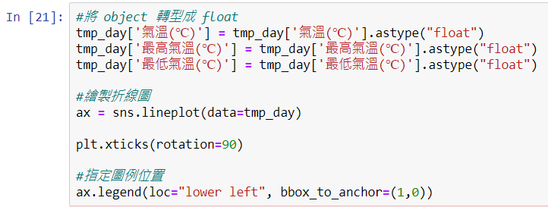
Draw multiple line charts (Cont’d)
If you want to display the legend of the chart somewhere, you can use the loc of the legend function.

Slide 44
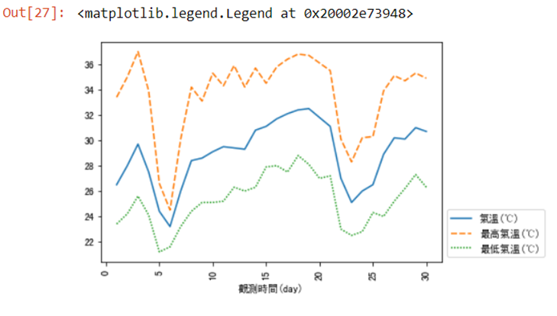
Draw multiple line charts (Cont’d)
Output:

Slide 45
Set the lines of the line chart to the same type
Put the attributes to be adjusted in the same column and adjust the format of the data (here, “氣溫種類”).
We can use the rename function to change the column name.

Slide 46
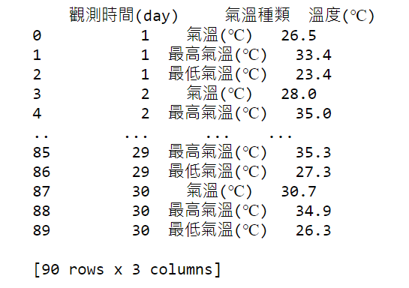
Set the lines of the line chart to the same type (Cont’d)
Output after using the rename function:

Slide 47
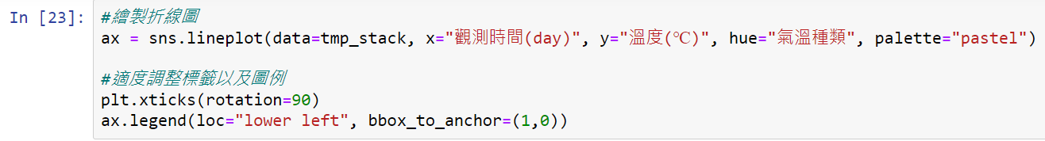
Set the lines of the line chart to the same type (Cont’d)
Use the parameter hue to specify the column to be written in different colors.

Slide 48
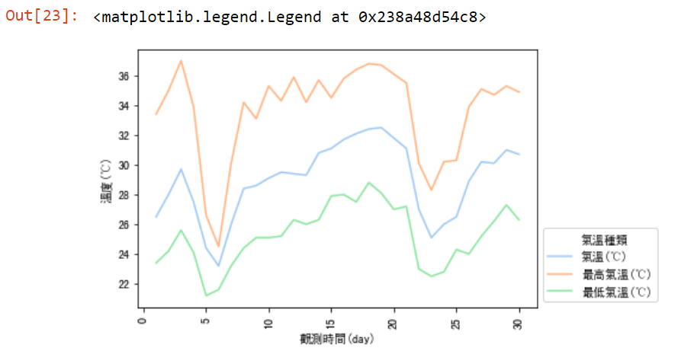
Set the lines of the line chart to the same type (Cont’d)
Output:

Slide 49
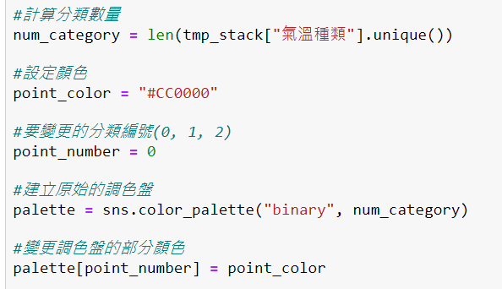
Highlight one of the line charts
Use the len function and the unique function to calculate the number of categories of "氣溫種類“.
Use the parameter palette of the sns.lineplot function to change the color of the palette.

Slide 50
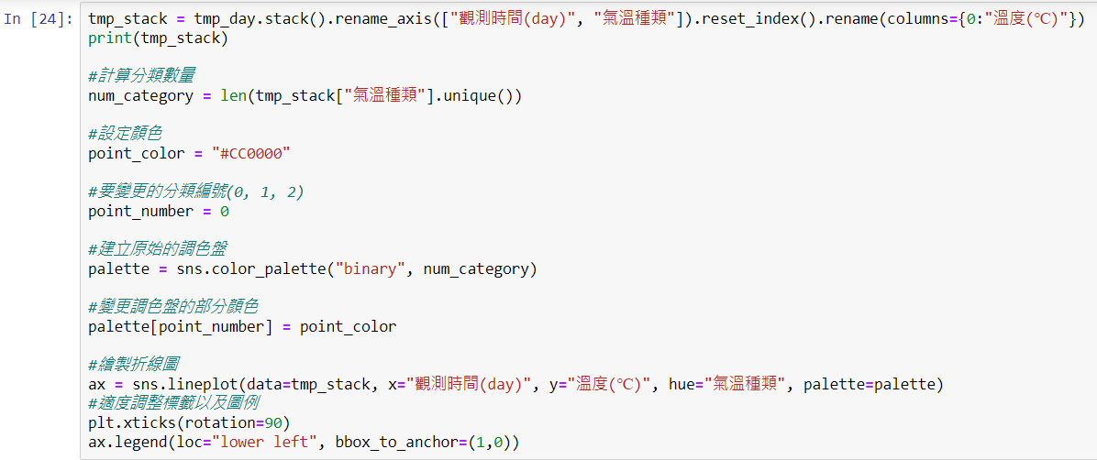
Highlight one of the line charts (Cont’d)

Slide 51
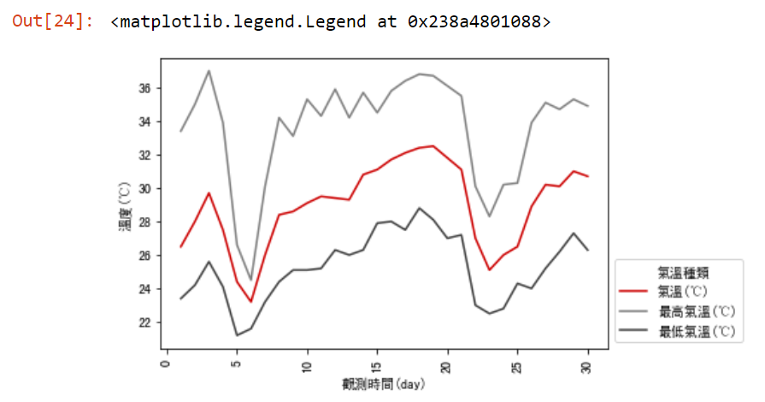
Highlight one of the line charts (Cont’d)
Output:

Slide 52
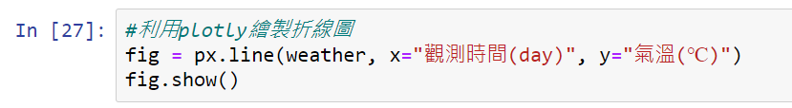
Use plotly to draw a line chart
If you use plotly to draw a line chart, the code can be very streamlined and the data can be displayed dynamically, for example: when the mouse is moved into the chart, the value at each time point will be displayed.
We can use the px.line function to draw a line chart.

Slide 53
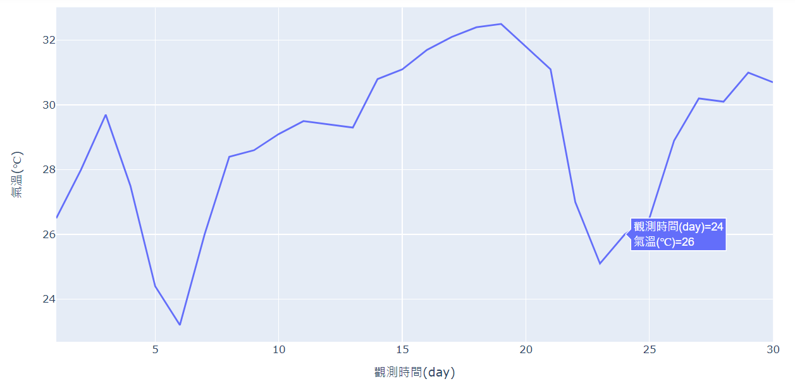
Use plotly to draw a line chart (Cont’d)
Output:

Slide 54
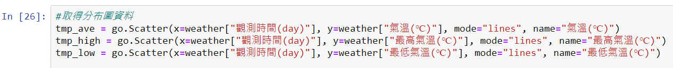
Use plotly to draw multiple line charts
If you want to use plotly to draw multiple line charts, you can define each line chart first, and then gather these line charts in a single chart.
First specify lines in the parameter mode of the go.Scatter function to create line chart data of different temperature types.

Slide 55
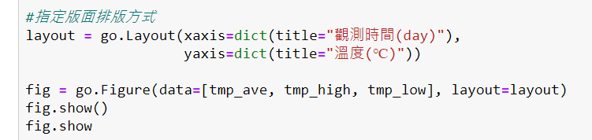
Use plotly to draw multiple line charts (Cont’d)
To integrate these line graphs into a single chart, the parameter data of the go.Figure function can be used to specify the line graph data list of different temperature types.

Slide 56
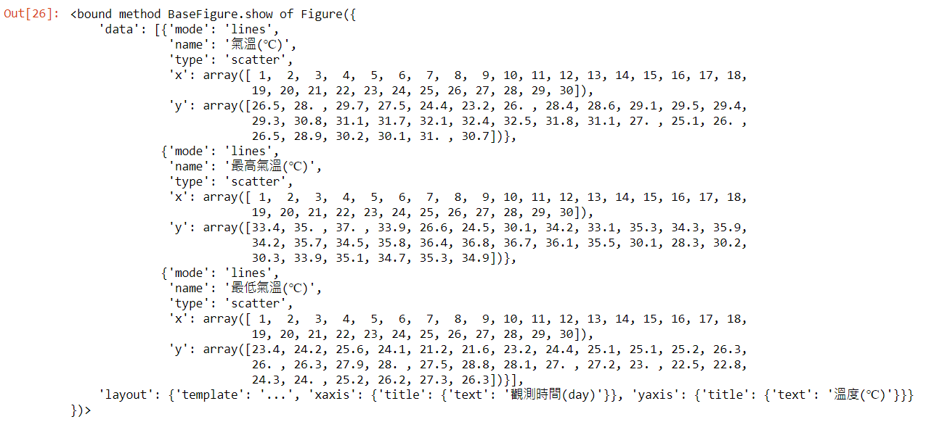
Use plotly to draw multiple line charts (Cont’d)
Tmp_ave, tmp_high, tmp_low data output:

Slide 57
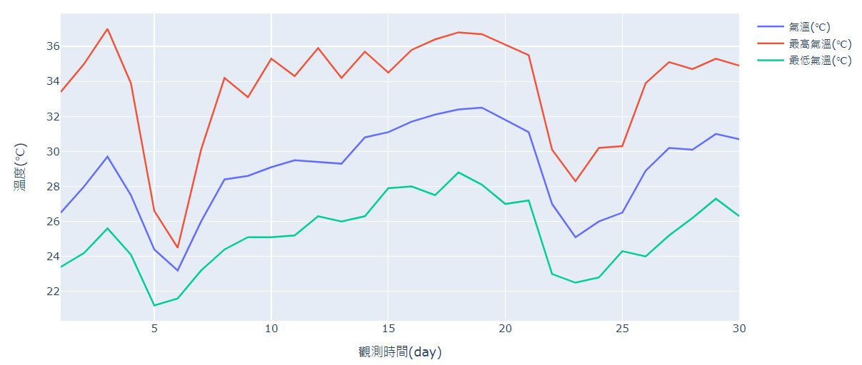
Use plotly to draw multiple line charts (Cont’d)
Multiple line charts output:

Slide 58

Smooth the line chart
Use the scipy library to smooth the curve of the line chart.
The linspace function in Numpy can spread points evenly within a certain range.
For example, if we want to generate 10 points between 1 and 5, our program can be written as follows.

Slide 59

Smooth the line chart (Cont’d)
First use make_interp_spline() to determine the coefficients of the spline to draw a smooth spline.
Optional parameter num is the number of samples to generate within the range from start to stop.
We take 300 equally spaced samples between min and max values along the X-axis to plot the curve.

Slide 60

Smooth the line chart (Cont’d)
The scatter chart can be drawn with the scatter() function, the parameter x can specify the column of the horizontal axis, and the parameter y can specify the column of the vertical axis.
The parameter color can specify the color of the dots, and the parameter alpha can specify a value between 0 and 1. Make the color of the dots transparent.

Slide 61

Smooth the line chart (Cont’d)

Slide 62

Smooth the line chart (Cont’d)
Output:

Slide 63

Smooth the line chart (Cont’d)
Use the title() function to add a title to the line chart.
Use the x.label(), y.label() functions to add labels to the x and y axes.

Slide 64

Smooth the line chart (Cont’d)

Slide 65

Smooth the line chart (Cont’d)
Output:

Slide 66

Chinese display problem
If you have encountered an abnormal display of Chinese, please go to the URL provided by us, and follow the instructions of the website to solve the abnormal display.
URL link: https://www.getit01.com/p20190120250957403/

Slide 67

Draw a map of the administrative regions of the United States
Load the library that will be used.

Slide 68

Draw a map of the administrative regions of the United States (Cont’d)
First use the folium.map function to define the map, and then use the folium.Choropleth function to draw a colored map of the administrative regions of the US states.

Slide 69

Draw a map of the administrative regions of the United States (Cont’d)
US states:

Slide 70

Number of cases of COVID-19 in U.S. states
Create a csv file (covid_usastate) of the number of people diagnosed with covid-19 in each state in the United States, and use it as data to draw a heat map.

Slide 71

Heat map of cases diagnosed with COVID-19

Slide 72

Heat map of cases with COVID-19
Draw a heat map based on the number of diagnoses in each state:

Slide 73
Convert total cases into ratio
However, due to the uneven distribution of the population, the previous picture failed to show the actual severity of each state truthfully.
Therefore, we need to add the population of each state and convert the number of diagnosed cases into a ratio to increase the readability of the data.
So, we create another csv file (new_covid_usastate), and draw the heat map with the ratio of diagnoses cases in each state as the data.

Slide 74

Heat map of ratio diagnosed with COVID-19

Slide 75

Heat map of ratio with COVID-19
Draw a heat map based on the ratio of diagnoses in each state:

Slide 76
Appendix

Slide 77

Open Jupyter Notebook
Enter jupyter in the search box on windows, and the search result of Jupyter Notebook will pop up.

Slide 78

Change browser
After clicking Jupyter Notebook, the preset browser will start. If you want to change the browser, you can copy the URL under the Prompt of Jupyter Notebook and paste the URL into the browser you want to use.

Slide 79

Create a new notebook
Select "Python 3" from the "New" drop-down menu in the upper right corner.

Slide 80

Change file name
Click "Untitled" on the right side of the Jupyter logo and enter the new file name, click "Rename" to confirm that the file name update is complete.

Slide 81

Program execution
Please enter print("Hello World") in the cell.
Click "Run" to execute the program, or you can directly press "Shift" + "Enter" to execute.

Slide 82

Install library
Assuming an error occurs when running the sample file, please confirm whether the necessary library is installed. If it has not been installed, please start Anaconda Prompt to install it.

Slide 83


Install packages
Enter conda install (library name) to install the necessary packages.
If you can't install it with the conda command, change it to pip install (library name).

Slide 84
Exercise

Slide 85


Exercise 1
Please find an article you are interested in on ptt and the number of pushes are greater than 50 to draw a word cloud.
Change the mask of word cloud above to a circle.

Slide 86

Hint
If the URL you enter has R-18 restrictions, you can use the following code to crawl pushes.

Slide 87


Exercise1 example

Slide 88
Exercise 2
Please get the weather data for any month and any region from the website we provide. Draw the "氣溫(℃)", "最高氣溫(℃)", and "最低氣溫(℃)" as a line chart and highlight the "最高氣溫(℃)".
Draw "氣溫(℃)", "最高氣溫(℃)", and "最低氣溫(℃)" as a line chart and smooth it.
URL link: http://e-service.cwb.gov.tw/HistoryDataQuery/MonthDataController.do?command=viewMain&station=C0AC70&stname=%25E4%25BF%25A1%25E7%25BE%25A9&datepicker=2021-08

Slide 89


Exercise2 example

Slide 90
Exercise 3
Please go to the GitHub folder we provided, download and upload all files to Jupyter Notebook at first.
Draw the number of death cases of COVID-19 in U.S. states as heat map.
Draw the heat map of death rate with COVID-19 in U.S. states.
GitHub link: https://github.com/emotionmax/Python-Data-Visualization/tree/main/Data
Please draw a heat map based on the Death_cases and Death_rate in covid_us_states.csv according to the file we provided in GitHub, please do not change the data without authorization.

Slide 91

Exercise3 example
Draw the number of death cases of COVID-19 in U.S. states as heat map.

Slide 92

Exercise3 example (Cont’d)
Draw the heat map of death rate with COVID-19 in U.S. states.

Slide 93
Exercise 4
Search the information on the internet you are interested in and draw it to a heat map.
For example: heat map of GDP per capita in various countries, heat map of global vaccine coverage, heat map of number of confirmed cases of COVID-19 in Japan, etc.

Slide 94
End

